Slide 1
Testing AC-DC Full Bridge
By: William Poole and Austin Morin

Slide 2
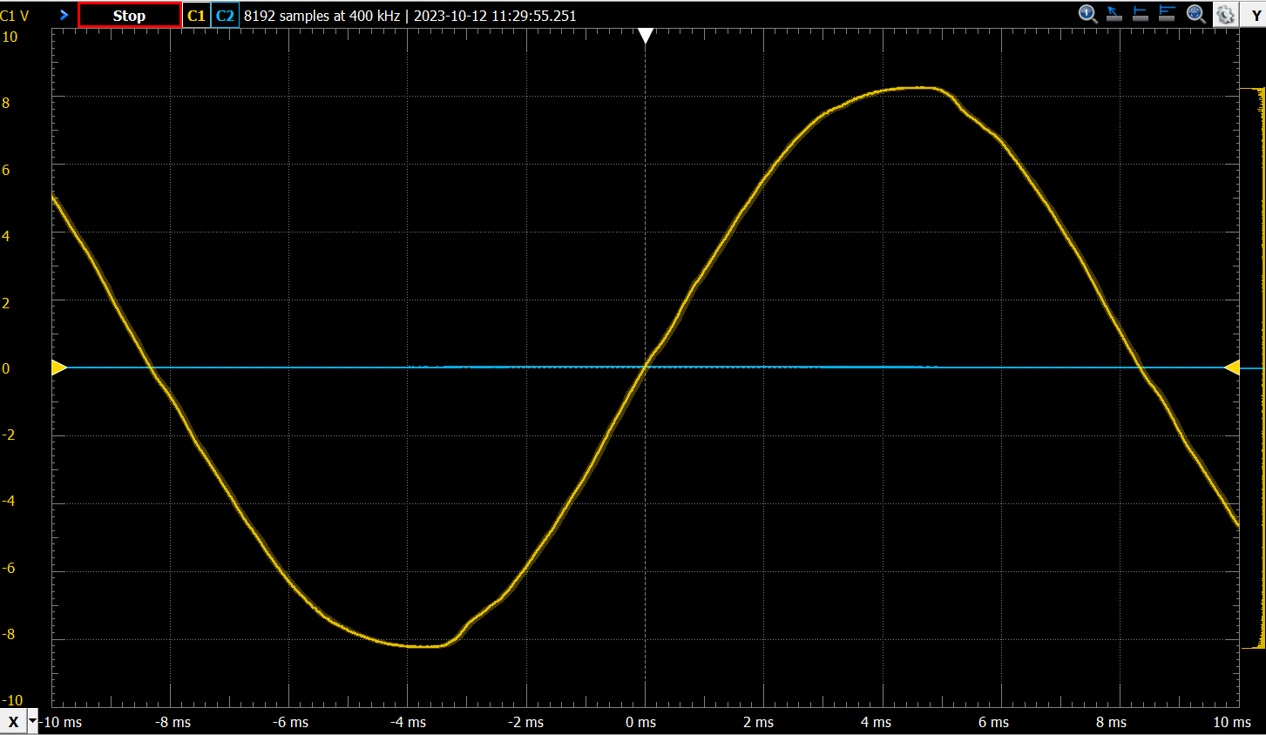
Input Signal Out of Transformer
~8V sine wave
Period ~>16ms 60Hz
8V/1.41=5.67Vrms
Fluke 117 5.87Vrms
Matching

Slide 3
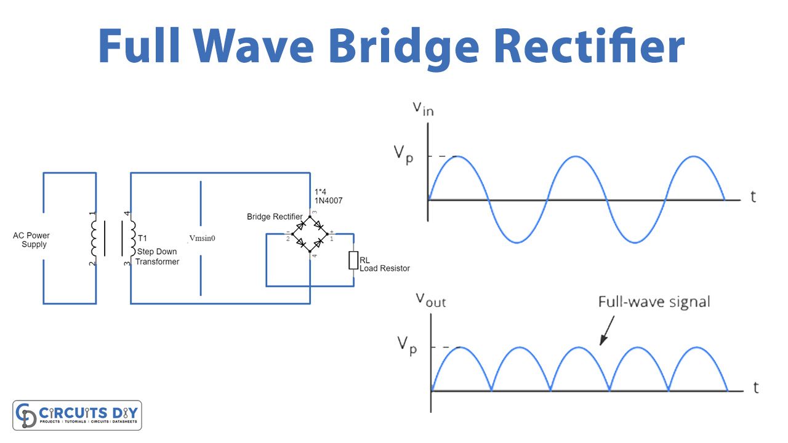
Desired output of Full Bridge
Output should be |Vin|-2*Vdiode=Vout

Slide 4
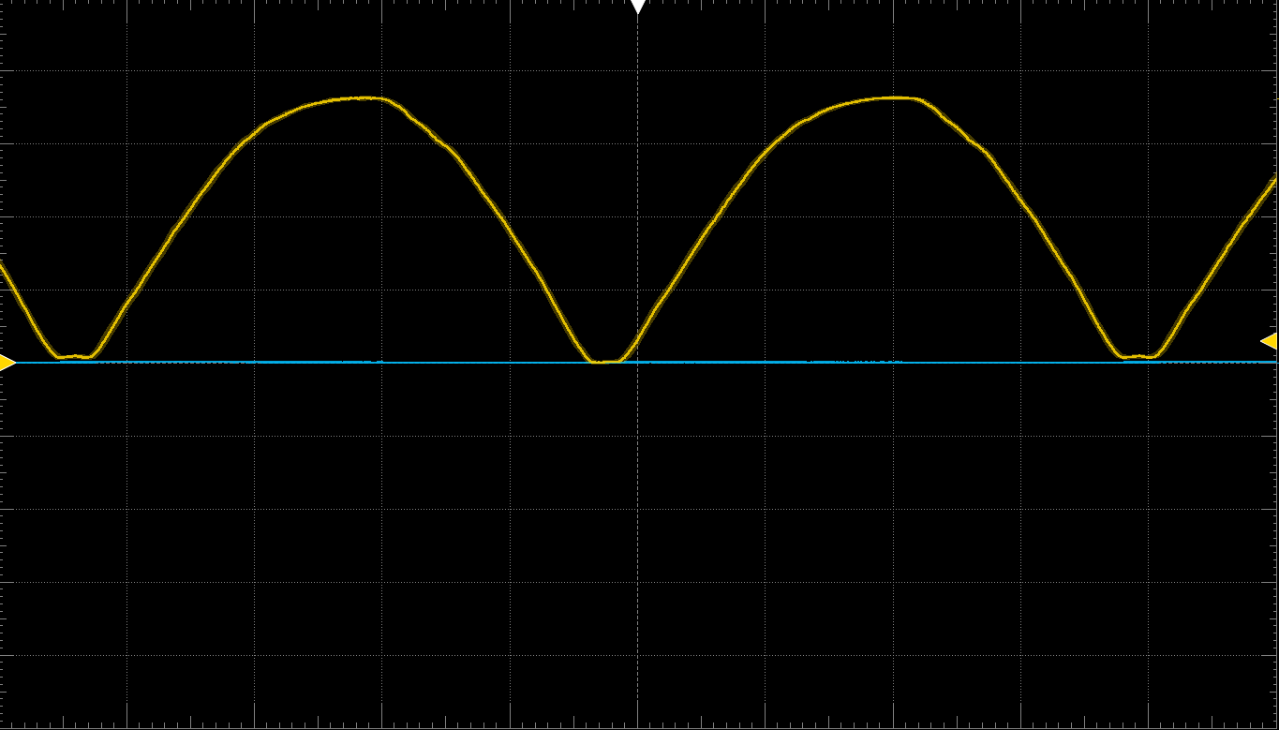
Full-Bridge Output
Success

Slide 5
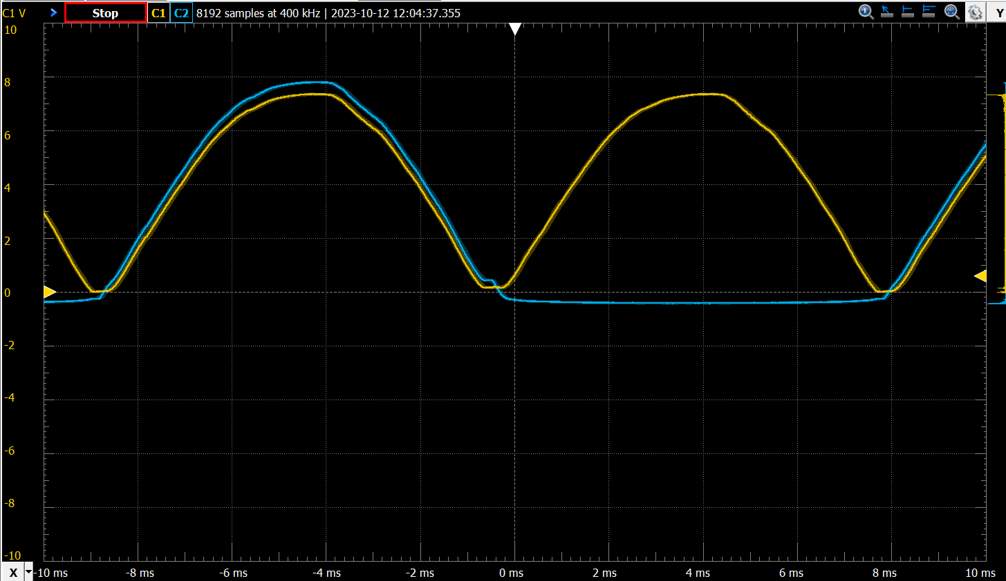
All Input Plus drop

Slide 6
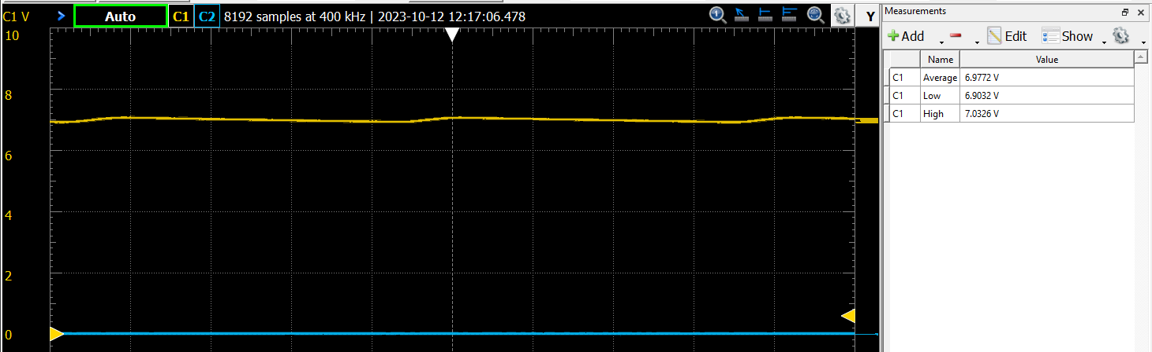
Full bridge to Regulator after connection

Slide 7
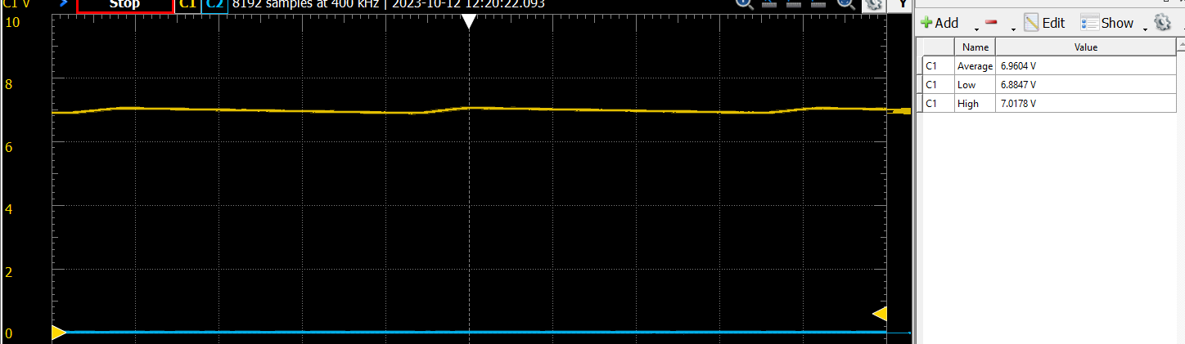
Vout Measured
Success but to high need to drop ~1.88V

Slide 8
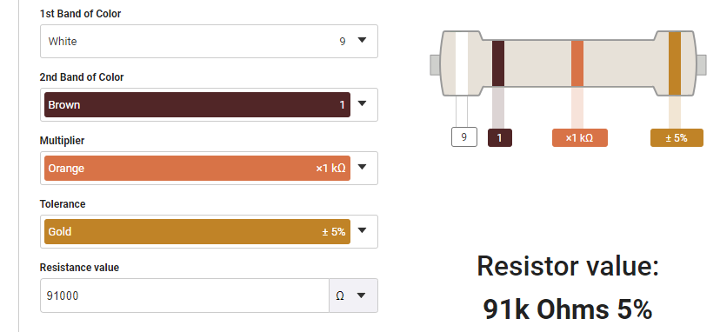
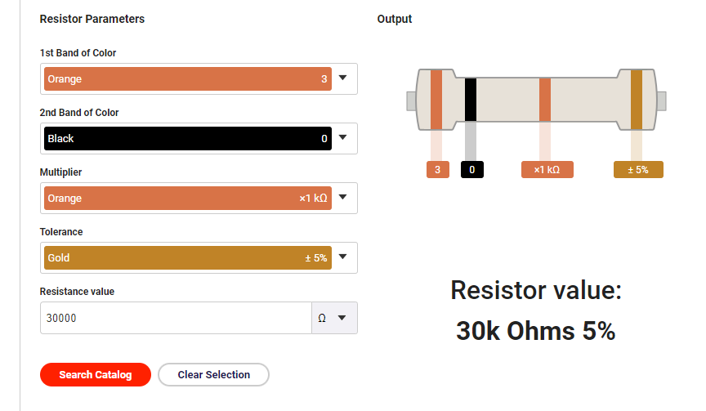
Feedback
White-Brown-Orange-Gold R1: 91k
Orange-Black-Orange-Gold R2: 30k
Vout=6.9V
Vr1~=6.9*30/(91+30) = 1.7V
Vout desired = 5V
R2=30.1k
R1=(5*30k/1.7)-(1/30k)-30k=~58k

Slide 9
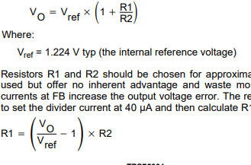
Supposed to Be 1.224V
1.224V is ref
6.9V -> 5V@1.7V 57k R1
To get 1.7V to match earlier voltage
Soldered together 27k+30k
6.9V -> 6.9V@1.224V
R2=30.1k
R1=(6.9*30k/1.2)-(1/30k)-30k=~136.935k
Soldered together 130k+7k

Slide 10
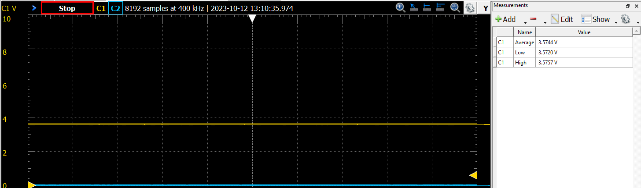
Testing With 57K
Resultant value was 3.6V average but with a great ripple

Slide 11
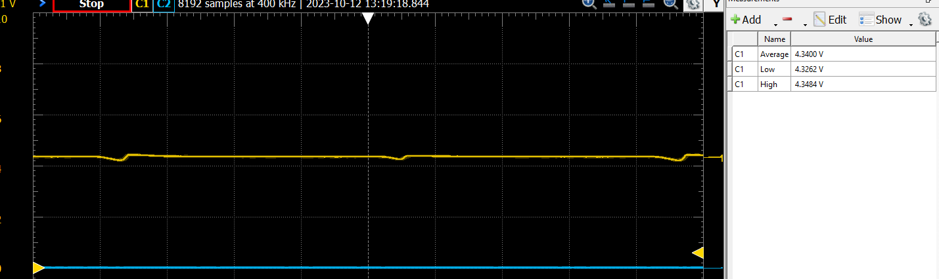
Weighing between values
Trying 75k 4.34V output,

Slide 12
Checking next best value
6.9V-> 90k [0.00007667V/ohm] ->5v 65k
3.57V->57k [0.00006316V/ohm] ->5v 79k
4.34V->75k [0.00005787V/ohm] -> 5v 86k
Trying 82k

Slide 13
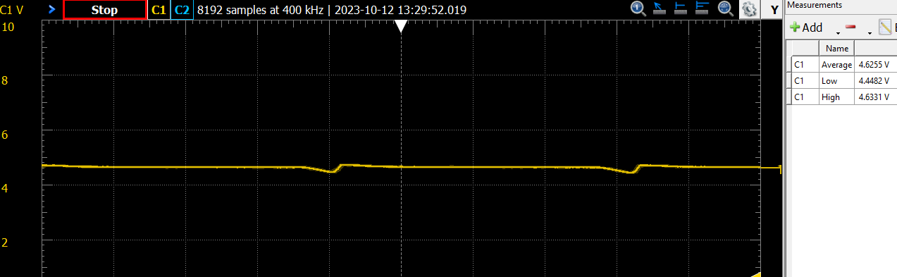
82k output

Slide 14
Add a series 10k now to adjust

